Slide 1
Klein oak hosa march meeting
March 2, 2017

Slide 2
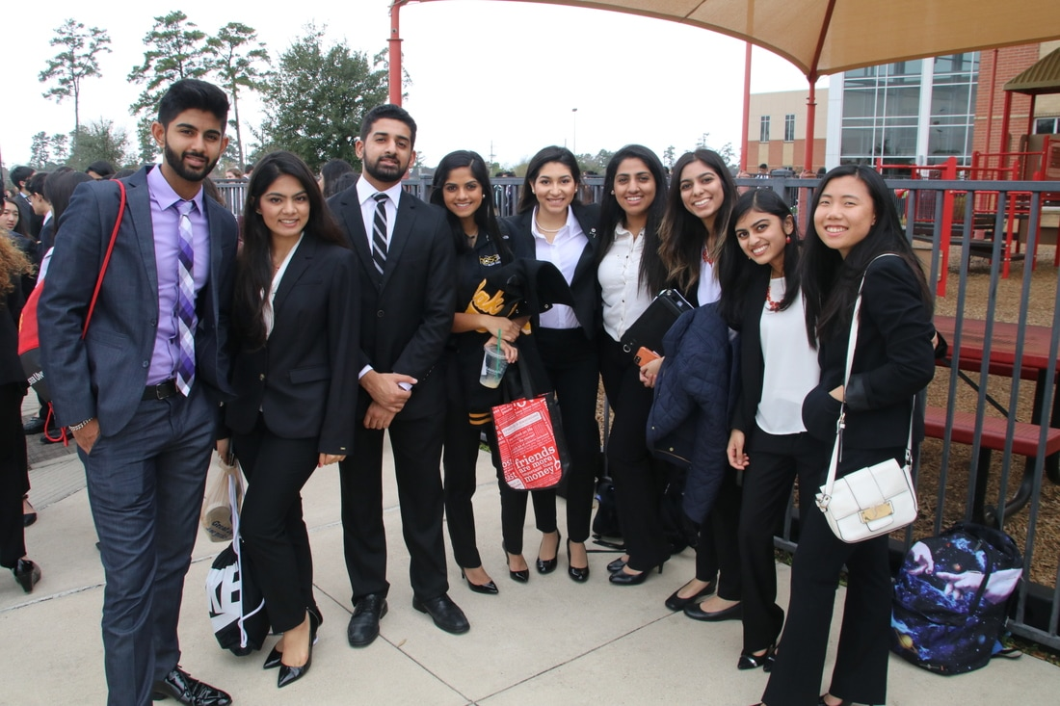
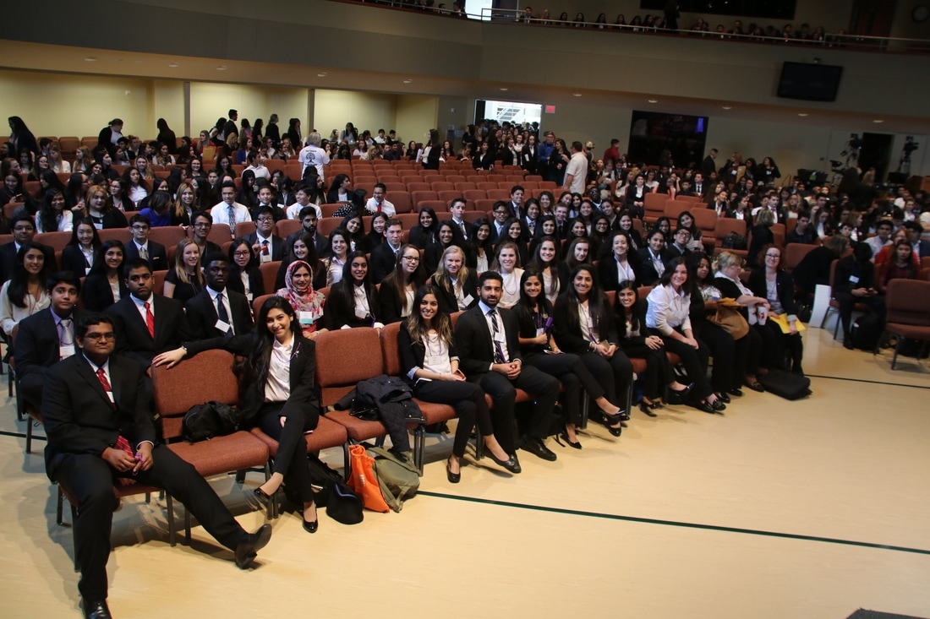
CONGRATS TO ALL THAT COMPETED!!!

Slide 3
Upcoming events
March 4th- Woodlands Marathon (6:45am-12:00pm)
March 18th- Cystic Fibrosis (Last Saturday of Spring Break) 8:00am-12:00pm
April 1st- Muddy Trails 5K (2:00pm- 8:00pm)
April 21st- Northampton Colt Stampede (5:45pm-9:00pm)
May 12th- End of Year Banquet

Slide 4
End of Year banquet
When? Friday May 12^{th (7:00pm-11:00pm)}
Where? Spring Chateau
Attire: Semi-formal
Plus 1: $25

Slide 5
Officer elections
More info coming end of March, check Blackboard!!!

Slide 6
HOSA STATE
Mandatory State Competitors Meeting: 3/7 & 3/8
After school in 301-A (Lee)
Only attend ONE of the meetings
Remind
Text @7egf39 to 81010

Slide 7
INTERESTED IN TAKING AN UPPER LEVEL HEALTH SCIENCE COURSE?
CHECK BLACKBOARD FOR UPPER LEVEL HEALTH SCIENCE COURSE INFORMATIONAL MEETING DATES

