Slide 1
WELCOME BACK!
September 1, 2016

Slide 2
2016-2017 HOSA ADVISORS
MS. WATTS
MS. CHEATHAM
MS. LEE
MS. JACKSON

Slide 3
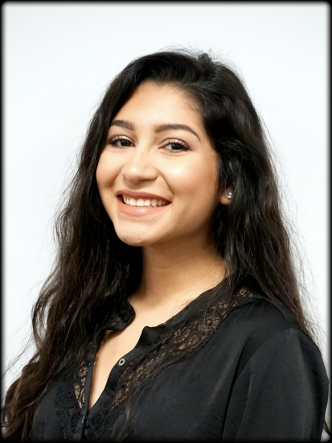
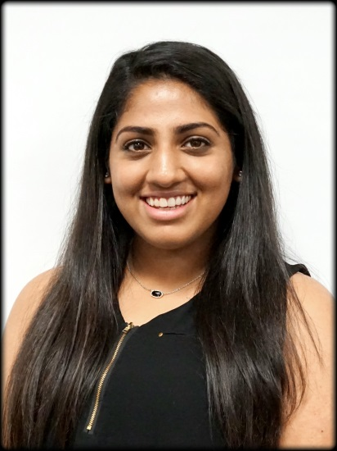
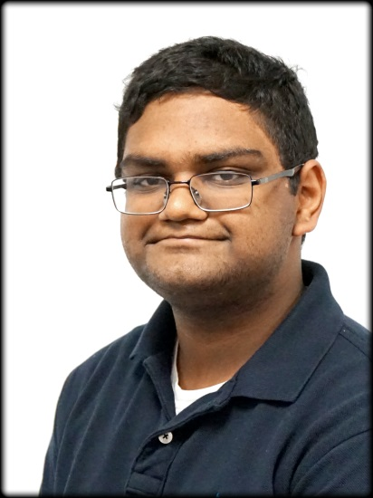
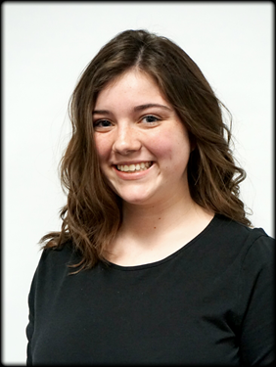
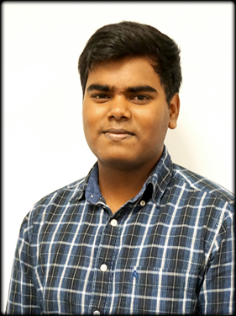
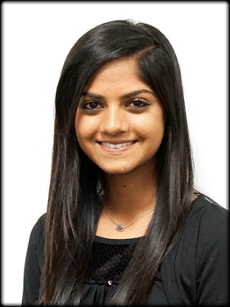
OFFICERS
Maireny Mundo
Saherish Badarpura
Abhishek Bansal
President
Vice President
Madelyn Oliver
Joel Pereira
Anjali Modak
Secretary
Historian
Reporter

Slide 4
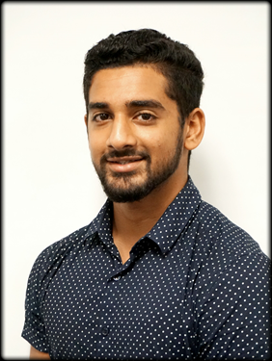
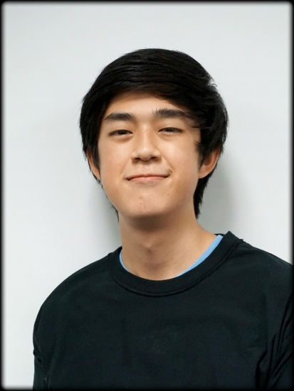
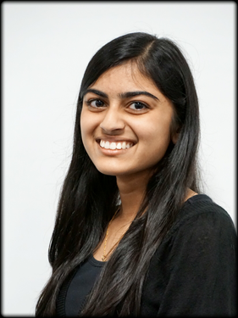
OFFICERS CNT.
Soha Allaudin
Munir Badarpura
Community Service
Chair
Dan Huynh
Tasneem Dollar
Rhea Sudhakaran
Competitive Events
Chair
Social Chair

Slide 5
WHAT IS HOSA?
Klein Oak HOSA is an organization for students interested in the health or medical field. HOSA promotes service to the community, and volunteering is a big part of our organization. Members can participate in volunteering events at nursing homes or attend walks that raise awareness for certain diseases, such as Light the Night and Relay for Life. Also, HOSA competition - at area, state, and national levels - gives HOSA members opportunities to expand and use their knowledge in health or medical areas, as well as being able to network and build life-long friendships.

Slide 6
REGISTRATION AND DUES
Member AND Competing: $140
Member ONLY: $100
Due on OCTOBER 4, 2016
OCTOBER 11, 2016 FINAL DAY TO TURN IN FEES
LATE DUES WILL INCUR AN ADDITIONAL $10 FEE
Anyone who turns in dues after October 11th will be unable to compete.
Dues include:
Membership
T-shirt
End of year banquet
Letter jacket
Cord
Area, state, & nationals expenses
Notes:
Mention: if forms are not in by oct. 11, member is unable to compete BUT may still be a member of HOSA if advisors are aware of situation (this is due to HOSA competing registration)

Slide 7
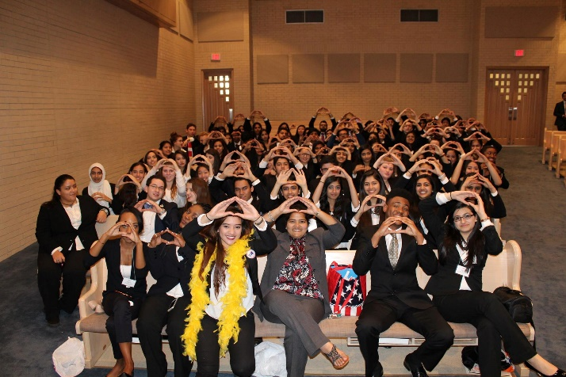
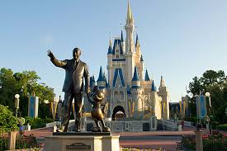
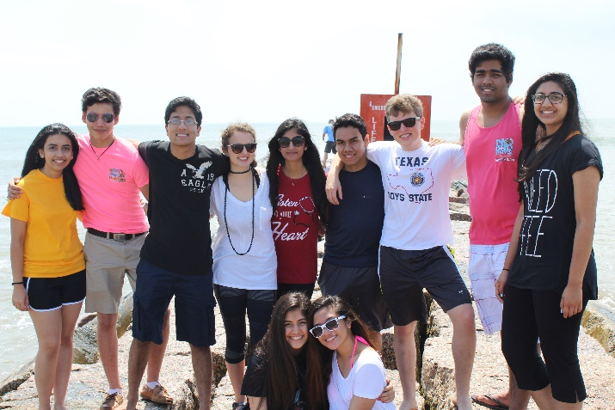
COMPETITION
ONLINE TESTING: (Nov. 20-Dec. 2)
AREA: KLEIN HIGH SCHOOL (Feb. 10-11)
STATE: CORPUS CHRISTIE (Mar. 31-Apr. 1)
NATIONALS: DISNEY!!! (June 21-24)

Slide 8
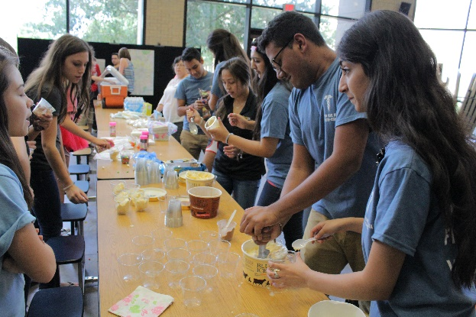
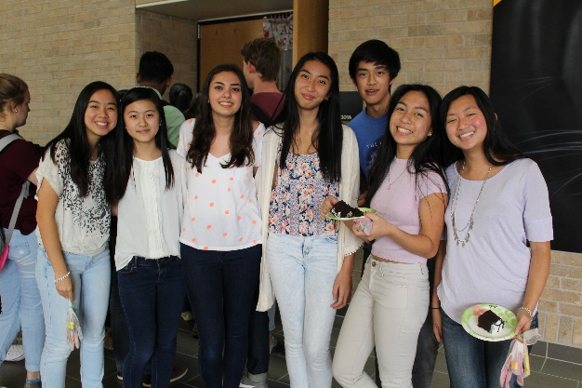
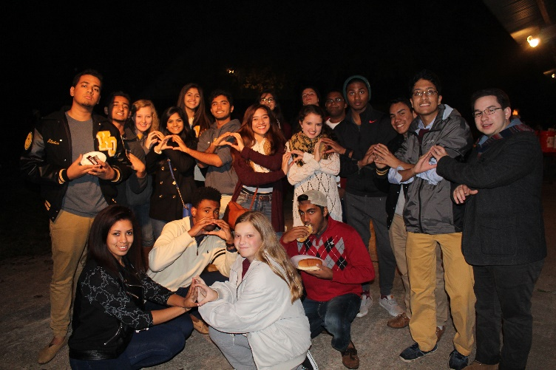
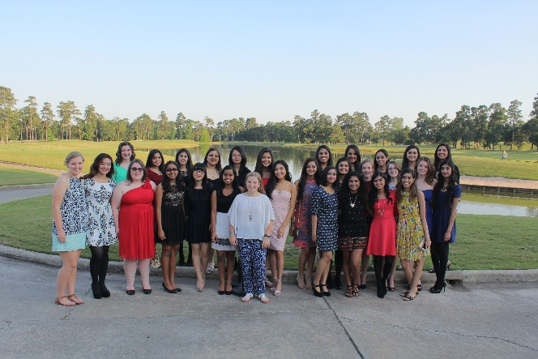
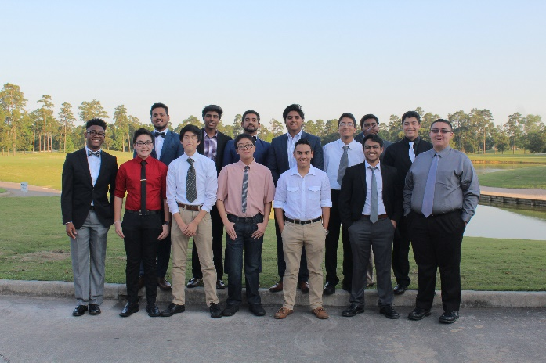
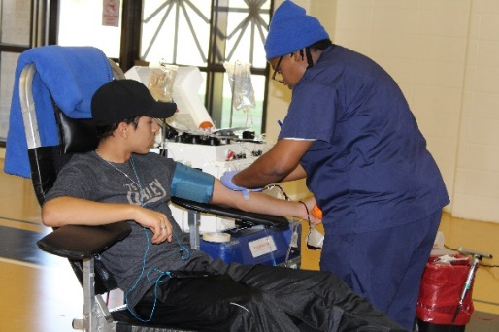
FUN STUFF
ICE CREAM SOCIAL
HALLOWEEN PARTY
WINTER SOCIAL (CHRISTMAS TREE FARM & HAY RIDES)
VALENTINES DAY PARTY
RELAY FOR LIFE
BLOOD DRIVE
HOSA OLYMPICS
BANQUET

Slide 9
HOW TO LETTER
Minimum of 8 points must be earned to receive letter jacket. The earliest a student can receive their letter jacket is their sophomore year.
HOW TO EARN POINTS
2 points: attending & competing at HOSA Area
4 points: attending & competing at HOSA State
2 points: joining HOSA at the beginning of the sophomore year and participating in HOSA Area
3 points: joining HOSA at the beginning of junior year and participating in HOSA Area
4 points: joining HOSA at the beginning of senior year and participating in HOSA Area
2 points: completing 10 hours of approved HOSA community service hours on or before April 1st of the current school year
***Students forfeit participation points for the year if they become ineligible to participate in HOSA competitions for any reason, Ex: failing, ISS, OSS, or expulsion
Notes:
Mention: certain events have online comp., they determine conference participation but are not considered competition at area level, certain events have online comp. that advance the student to the state comp. Placing in the online competition is not considered competition at the state level. Seniors can receive letter with HOSA advisors discretion and principals approval even though they may not have fulfilled the requirements set forth above.
STUDENT IS RESPONSIBLE FOR CONTACTING A HOSA ADVISOR IF THEY BELIEVE THEY QUALIFY FOR A HOSA LETTERMAN

Slide 10
HOW TO EARN A HOSA CORD (must fulfill at least 1 of the options to qualify for graduation cord)
Option 1:
Student must have taken CNA/EMT/Health Science/Pharm Tech AND have a semester average of at least 90 in all Health Science courses taken including:
A & P, CNA, EMT, Health Science, Medical Microbiology, Pharm Tech, PHS, World Health
Option 2:
Student must participate in HOSA for 4 years AND must earn 10 community service hours per year until the year of their graduation (starting 2016/2017 school year)
Option 3:
Student must advance to HOSA Nationals

Slide 11
Volunteer Forms
Notes:
Find on: Blackboard and Website

Slide 12
UPCOMING EVENTS
September 8: Ice Cream Social (After school in Senior Den)
October 6: Fall Social (immediately after, after school meeting)
October 16: Light the Night (10am-1pm) or (1pm-4pm)
October 29: MS Walk
November 17: Rockets Night (seniors & juniors only)
December 10: Jingle Bell Run
TBD: Winter Social (Christmas Tree Farm)

Slide 13
AAR No-Kill Animal Shelter
Contact: aarescue03@yahoo.com

Slide 14
2016-2017 T-SHIRTS

Slide 15
Social Media
INSTAGRAM
@kohosa
TWITTER
@ko_hosa
WEBSITE
http://kohosa.weebly.com/
REMIND 101
Text
@ebg2f
To
81010

