Slide 1
HOSA Competitive Event Outline and Guide (Everything you need to be successful at Competition)

Slide 2
Online Testing Events General Guidelines
Online testing consists of events that covers medical related subjects. These tests can consist of around 50 to 100 questions covering the material about each of the subjects. The time limit will vary based on event and how many questions are given, but usually will range from an hour to an hour and a half.
Competitors can prepare for these events by reading the event materials which usually consist of textbooks. In addition there are lots of online resources to help prepare competitors such as Quizlet. Make sure to start reading at least a month in advance to better absorb the information and not cram the week of competition.
These books often have practice questions in the back of each section/chapter that reflect the questions on the actual tests and are very useful.
These events typically proceed directly to state if competitors achieve top 3 scores, which are relative.
Good for people who memorize and read well and have lots of time to study.

Slide 3
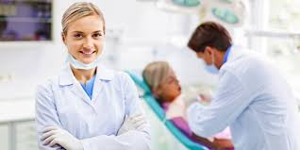
Dental Terminology
An online testing event, this event shall be a written test dealing with dental terminology, including prefixes, suffixes, roots and anatomy, physiology and pathophysiology. Competitors will recognize, identify, define, interpret and apply dental terms in a 100 item multiple choice test. Plus 20 tie-breaker questions. (These are usually much harder than the other 100)
This event is good for those who can memorize information and are good at reading, a book is provided for this event. This is for people who like the dental field and are interested in dental terms.
Dental specialties (related procedures, terminology, and spelling) consists of 40% of the test
Instruments and material- 20%
Prefixes, suffixes, and combining forms- 10%
Anatomy & Physiology- 10%
Infection control and Emergency care- 10%
Ethical and legal aspects- 5%, Radiography- 5%
The official references for the selection of all words and terms shall include: • Dofka, Charline M. Dental Terminology. Cengage Learning. Latest edition. • Mosby. Mosby’s Dental Dictionary. Elsevier Health Sciences, Latest edition. • Stedman’s Medical Dictionary for Dental Professions. Lippincott, Williams and Wilkins, Latest edition.
Notes:
Talk about the material percentage distribution and where you can find information on it at HOSA.org

Slide 4
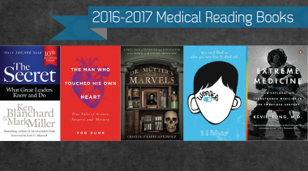
Medical Reading
Event is an online testing event. Competitors will apply, analyze, synthesize and/or evaluate the reading material in a 50 item multiple choice test (10 questions per book) plus one tie-breaker essay question in 60 minutes. Written tests will measure knowledge and understanding at the recall, application and analysis levels. Higher-order thinking skills will be incorporated as appropriate.
This event is good for those who can memorize information and are good at reading. Books change every year and are announced in July.
5 books
3 medical-related nonfiction (typically one biography)
1 medical-related fiction
1 leadership nonfiction

Slide 5
Medical Terminology
This event shall be a written examination dealing with selected terms common to health and others unique to the varied health specialties. Competitors shall be expected to recognize, identify, define, interpret and apply these terms in a 100 item multiple choice test. You will also be expected to know suffixes, prefixes and roots as well as occupations in the medical field.
This is a good test for people who can memorize lots of information pertaining to medical terms that are applied to the general profession. This is for anyone interested in the medical field and is good at studying ahead of time, as there will be a lot of information to absorb.
Reading Material:
• Ehrlich, Ann. Medical Terminology for Health Professions, Cengage Learning. Latest Edition.
• Taber's Cyclopedic Medical Dictionary. Edited by Donald Venes and Clayton L. Thomas, M.D. F.A. Davis Company, Latest edition.
• Stedman’s Medical Terminology. Edited by Judi Nath, Lippincott Williams & Wilkins, Latest edition.

Slide 6
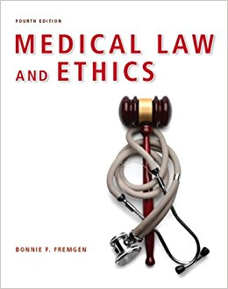
Medical Law and Ethics
This event will be a 100 item multiple choice written exam with an essay tie-breaker question. This test will consists of questions pertaining to laws and ethical situations surrounding the medical field and students will be given 90 minutes to complete the examination. Tiebreaker will consist of an essay over medical law and ethics and its importance.
Questions will measure knowledge at the recall, application and analysis levels. Each test will be related to a specific career or specialty area from within the health care community or related information that applies to several health specialties. This requires a lot of memorization skills as well as reading skills.
This is a good event to choose for anyone who is interested in law and its pertinence to the medical field. It is somewhat competitive and does require a lot of time and effort.
Medical Law and Ethics, 4th Edition by Bonnie F. Fremgen, University of Notre Dame

Slide 7
Nutrition
This event consists of a 100 item multiple choice written exam, with an essay tie breaker question. Each test is related to a specific career or specialty area; questions measure knowledge at the recall, application and analysis levels. Students will be given 90 minutes to finish and complete the exam. This requires a lot of reading and memorization over nutritional facts and knowledge about the importance of nutrition in the healthcare field.
This is a good choice for anyone who is interested in healthy lifestyles and better eating habits as well as for those who plan to be a nutritional specialist.
Reading material: Nutrition & Diet Therapy, 11th Edition by Ruth A. Roth
Williams' Basic Nutrition & Diet Therapy, 14th Edition by Staci Nix, MS, RD, CD

Slide 8
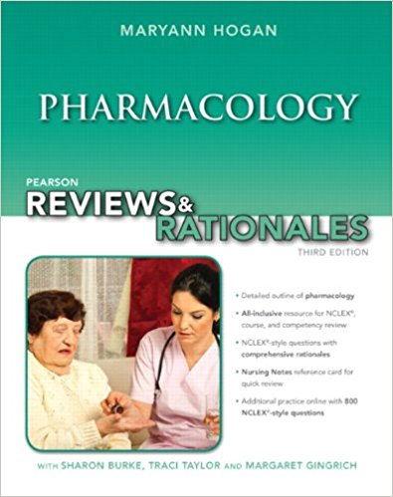
Pharmacology Knowledge Test
This knowledge test comprises 100 item multiple choice questions and a written tie breaker essay that tests the students knowledge about the spelling, definition, and application of science common to pharmacology in the health field; competitors will define, interpret and apply pharmacology terms and information. This requires an extensive amount of reading as well as higher memorization skills, this event is very competitive and requires lots of time as well.
This event is a good choice for anyone looking to be a pharmacist later on or for those who have taken higher med classes at school and have prior knowledge.
Reading material:
Fulcher, Soto and Fulcher. Pharmacology: Principles and Applications. Elsevier, Latest edition.
Ford, Susan and Sally Roach. Roach’s Introductory Clinical Pharmacology. Lippincott, Williams and Wilkins, Latest edition.

Slide 9
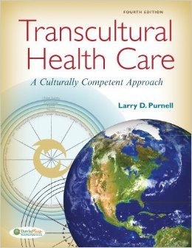
Transcultural Health Care Knowledge Test
This event consists of 100 item multiple choice questions that tests student’s ability to explore and learn about the importance of cultural competence for the promotion of health, the prevention and treatment of diseases and disorders, and the support of those in a diverse health community. As usual per knowledge tests, this event will consists of a written tie breaker question. It is very heavily based on current medical field knowledge about treating patients from all different cultural backgrounds. It does cover lots of information about patients from all over the world and from different ethnic backgrounds so good memorization skills are needed as well as higher thinking and the ability to empathize.
This event is very good for those who are interested in other people’s backgrounds such as ethnic cultures and religions from around the world and how to treat them.
Reading material:
Purnell, Larry. Transcultural Health Care: A Culturally Competent Approach, FA Davis.
Spector, Rachel E. Cultural Diversity in Health and Illness. Prentice Hall.

Slide 10
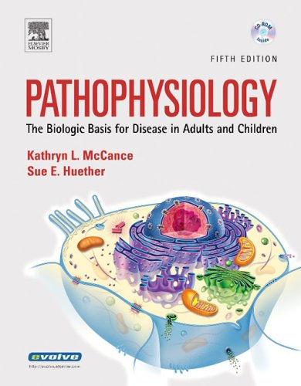
Pathophysiology Knowledge Test
This event consists of a 100 item multiple choice test that will determine student’s ability to identify, spell, define and apply the prefixes, suffixes, roots, anatomy and physiology of human diseases impacting the health community. Followed by a written free response essay. This event is based a lot on spelling so a good knowledge of how words work (especially Latin roots and suffixes) will be very helpful. A current understanding of diseases and how they work is very important for this event.
This event is good for those who are good with facts about diseases and spelling as well as memorization of facts and information, this event is very competitive.
Reading material:
Frazier. Essentials of Human Diseases and Conditions. Elsevier, Latest edition
Zelman, Mark; Raymond, Jill; Holdaway, Paul; Dafnis, Elaine; Mulvihill, Mary Lou. Human Diseases A Systemic Approach. Pearson. Latest edition.

Slide 11
Behavioral Knowledge Test
This test consists of 100 item multiple choice questions and is designed to test students’ ability to explore and learn about the promotion of mental health, resilience and well-being; the prevention and treatment of mental and substance use disorders; and the support of those who are in recovery. This will be followed by a free response essay. This test is very beneficial for those who have taken psychology at school or for those who are interested in the brain and the human mind.
This test consists of lots of information based on psychology and the way patients interact with the medical professionals treating them. This consists of lots of information and it is important to study as well as have good memorization skills and reading skills.
Reading material:
Cacioppo, John and Laura Freberg, Discovering Psychology. Cengage Learning, Latest edition.
Substance Abuse and Mental Health Services Administration website

Slide 12
Human Growth and Development Knowledge Test
This event consists of 100 multiple choice questions followed by a free response essay that will be written for a tiebreaker. This events tests students’ knowledge based on the stages of human growth and development, including the biophysical, mental/cognitive, social, and emotional development in the health community. This is also a good event for those who have take psychology in school or for those who are interested in the mind and brain.
This event consists of a lot of information pertaining to how the mind works and also how it ties into psychological development of patients in the medical field. Lots of reading is involved so good reading skills and memorization skills will be important.
Reading Material:
Polan, Elaine and Daphne Taylor, Journey Across the Lifespan: Human Development and Health Promotion. F.A. Davis, Latest edition.
Leifer and Fleck. Growth and Development Across the Lifespan. Saunders, Latest edition.
Simmers, L., Simmers-Nartker, Simmers-Kobelak. DHO: Health Science. Cengage Learning, Latest edition.

Slide 13
Free Response Based Test Events
Notes:
Talk about what categorizes these events, and how they are very open ended

Slide 14
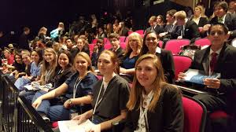
Medical Spelling
This event shall be divided into two rounds. Round One will be a 50 item multiple choice test. Competitors who score in the top 50% will advance to Round Two. Round Two will be a “spelldown” where competitors will orally spell terms. Competitors will be eliminated when a medical term is misspelled. The last remaining competitor in Round Two becomes the first-place winner. This event is designed to test students knowledge on memorization of important spelling and definitions of medical terms.
This event is great for those who are good spellers and can memorize lots quickly, the words can be very complex so be prepared to study lots over medical dictionaries. This event is also more competitive and is for those who can work well under pressure in front of a judge.
Materials for study: Medical dictionaries, quizlet, etc.
Taber's Cyclopedic Medical Dictionary. Edited by Donald Venes and Clayton L. Thomas, M.D. F.A. Davis Company, Latest edition.
Normal spelling bee rules apply for round two (spelldown) for more details visit http://www.hosa.org/sites/default/files/MS16Final.pdf

Slide 15
Medical Math
This event is a test that consists of 50 questions that will cover students’ ability to identify, solve, and apply mathematical principles involving temperature, weights, and measures used in the health community. There will also be 10 tie breaker questions as well to follow up. This event is for those who are good with numbers and can memorize questions, basically for those who are great at quick thinking with math and higher level math formulas. A basic calculator with addition, subtraction, multiplication and division will be provided. No conversion charts will be given during the test itself however it is a reference source.
This test is on scantron and 2 pieces of scratch paper will be allotted per each competitor, quick thinking under pressure is important for this event as time is a big constraint.
Reading material and study guide:
Helms, Joel R., Mathematics for Health Sciences: A Comprehensive Approach. Cengage Learning. Latest edition.
Simmers, L., Simmers-Nartker, Simmers-Kobelak. DHO: Health Science. Cengage Learning, Latest edition.

Slide 16
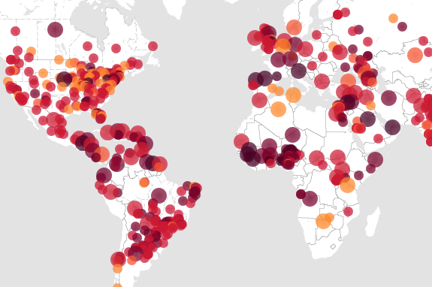
Epidemiology
This event consists of 50 item multiple choice questions and some free response case study questions, the purpose of this test is for students to study the effects of health and disease in populations, to improve their scientific literacy, and to provide insights into public health careers.
From HOSA: The test will consist of fifty (50) multiple-choice items, AND a case study consisting of between five (5) and twenty (20) short answer questions worth 50% of the final total score.
This tests is good for those who can memorize facts about diseases as well as know lots about the formulas needed to calculate the spread of diseases i.e. mortality rate. This requires lots of studying and practice to perform well. Case study questions can be found for practice online.
Study Material:
CDC Websites
http://www.cdc.gov/ophss/csels/dsepd/ss1978/lesson1/index.html
http://www.cdc.gov/ophss/csels/dsepd/ss1978/lesson6/section2.html
Basic Epidemiology – World Health Organization
http://apps.who.int/iris/bitstream/10665/43541/1/9241547073_eng.pdf

Slide 17
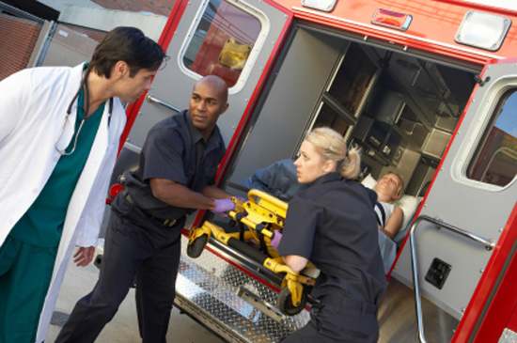
Skill Based Events (These events can be Group or Solo events)

Slide 18
Biomedical Laboratory Science (Solo event)
This event consist of 2 rounds of competition, the first round will be a written, multiple choice test. Written test will measure knowledge and understanding at the recall, application or analysis levels; There will be a maximum of 60 minutes to complete the test. The top scoring competitors will advance to Round Two for the performance of selected skills identified in a written scenario. The scenario will require the use of critical thinking skills. The performance will be timed and evaluated according to the event guidelines by a judge.
This event is for those who are interested by science equipment and the research that goes on behind the medical field. This is a very memory intensive event and requires lots of reading as well as a lot of hands on practice for the skill portion of this event. This is for those who like to work hands on with equipment and can do research.
Study Material:
Estridge and Reynolds. Basic Clinical Laboratory Techniques. Cengage Learning. Latest edition.
Daugherty, Ellyn. Biotechnology: Science for the New Millennium, Paradigm Publishing. Latest edition.

Slide 19
Healthy Lifestyle
This event consists of two rounds of competition. Round One will be a written, multiple choice test; that consists of 50 multiple choice questions. There will be a maximum of 60 minutes to complete the test. The questions will assess students’ knowledge of health literacy with topic such as exercise, eating healthy, and avoiding risky behaviors.
The top scoring competitors will advance to Round Two for a presentation in front of a judge where they talk about their efforts to live a healthy lifestyle through an interview and portfolio presentation.
The portfolio should include documentation on the student’s efforts to live a personalized healthy lifestyle. This should include quantitative data (i.e. calories eaten, time working out) and pictures.
This is good for people who are interested in working out or in starting a new diet, this would be great for those who want to get in shape.

Slide 20
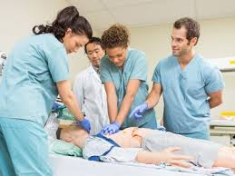
Clinical Nursing (Solo Event)
This event consists of two rounds of competition. Round One will be a written, multiple choice test; that consists of 50 multiple choice questions. There will be a maximum of 60 minutes to complete the test. The top scoring competitors will advance to Round Two for the performance of selected skill(s) identified in a written scenario, this will be evaluated by a judge according to the nursing guidelines.
This event requires a lot of practice and it is helpful if you have already taken a medical training course such as EMT. This event requires lots of reading and hands on work in front of others to be familiar with procedures.
Study Material:
Perry and Potter, Clinical Nursing Skills and Techniques, Elsevier Science/Mosby, Inc. Latest edition.
Timby, Barbara, Introductory Medical Surgical Nursing, Lippincott. Latest edition.

Slide 21
Clinical Specialty (Solo Event)
This is a more creative event that allows for imagination, competitors will develop a portfolio and demonstrate their knowledge in that area of choice for the career.
This event will consist of two items: a) the development of a career portfolio, and b) the demonstration of a selected skill common to the chosen health career. The career portfolio will be created by the competitor to show career understanding and documentation of a related work-based learning experience. The skill portion will consist of a digitally recorded demonstration of a skill related to the chosen career.
This event is good for those who have experience with job applications and who are good at speaking in front of a camera and developing good footage. This is a very oral event and doesn’t require much memorization but does requires lots of research and speaking skills.
Study material:
http://www.healthscienceconsortium.org/health-science-career-cluster/
https://explorehealthcareers.org/

Slide 22
Dental Science (Solo event)
This event consists of two rounds of competition. Round One will be a written, multiple choice test that will comprise 50 questions about dental history, instruments and anatomy. Competitors will be given 60 minutes to complete the test. Round Two will be the performance of selected skill(s) identified in a written scenario and will be evaluated and timed by a judge.
This event is for those who are very interested in not only the study of dentistry but also the practice of it. This event involves lots of studying but also a good amount of hands on practice with dental equipment and models; competitors should be able to work well under examination.
Study material:
Boyd, Linda. Dental Instruments: A Pocket Guide. Saunders, latest edition.
Halstead and Phinney. Dental Assisting: A Comprehensive Approach. Cengage Learning, latest edition.

Slide 23
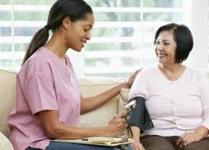
Home Health Aide (Solo Event)
This event consists of two rounds of competition. Round One will be a written, multiple choice test that is comprised of 50 multiple choice questions over being a health aide, competitors will be given 60 minutes to finish. The top scoring competitors will advance to Round Two for the performance of selected skill(s) identified in a written scenario, this will consist of performing specific skills over helping patients in a home health environment and will be judged and timed.
The specifics for the event performance indicators can be found at HOSA.org in the competitive folder, link here: http://www.hosa.org/sites/default/files/HHA16FINAL.pdf
This event is good for those who are interested in being a home health care provider and for students who have basic medical skills (i.e. CPR or checking for pulse) and can demonstrate compassion and quality of care.
This event requires lots of hands on practice and a good amount of studying, however it is not super competitive in the district.
Study material:
Balduzzi, Suzann. Homemaker Home Health Aide. Cengage Learning. Latest edition
Fuzy and Leahy. The Home Health Aide Handbook. Hartman Publishing, Inc, Latest edition.

Slide 24
Medical Assisting (Solo Event)
This event will consist of two rounds of competition. Round One will be a written, multiple choice test that comprises 50 questions in which competitors will be given 60 minutes. The top scoring competitors will advance to Round Two for the performance of selected skill(s) identified in a written scenario.
This test is great for those who are good with hands on practicing and who can perform well and speak in a professional manner. This event also doesn't have a high skill set and can be very competitive for people who practice a lot.
Study Material:
Blesi, Wise and Kelley-Arney. Medical Assisting: Administrative and Clinical Competencies. Cengage Learning. 7th edition.
Simmers, Louise. DHO: Health Science Cengage Learning, Latest edition.

Slide 25
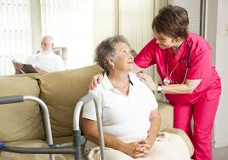
Personal Care event (special eligibility Event)
This event consists of an evaluation of student performance of selected skill(s) identified in a written scenario. The performance will be timed and evaluated according to the event guidelines.
In order to participate in this event, the competitor must meet all the following requirements:
MUST be classified under the provision of the 2004 reauthorized Individuals with Disabilities Education Act (IDEA).
Submit a completed form from the appropriate school official stating that the competitor is classified under the provisions of IDEA 2004 following the submission directions on page 16 of these guidelines. Five (5) bonus points will be awarded to the competitor for submitting the eligibility form correctly.

Slide 26
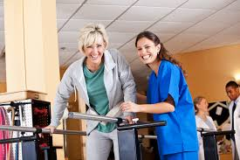
Physical Therapy Event (Solo)
This event consists of two rounds of competition, the first one will be a written, multiple choice test, it will be 50 questions that competitors will be given 60 minutes to complete. The test will consist of questions over the physical therapy methods for Musculoskeletal conditions, for cardiac conditions and for older people, etc. The second round will be The top scoring competitors from round one, that perform a specific set of physical therapy skills in front of a judge and patient.
This event is good for those who are interested in giving physical care for patients of many different diagnostic groups. This event requires lots of studying as well as memorization of many hands on skills through practice. It also requires students to be very caring and empathetic.
Study Material:
Simmers, L., Simmers-Narker, Simmers-Kobelak. DHO: Health Science. Cengage Learning, Latest edition.
Pagliarulo, Michael A. Introduction to Physical Therapy. Mosby. Latest edition.

Slide 27
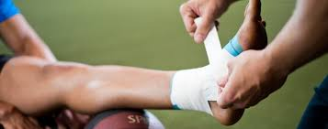
Sports Medicine (Solo event)
This event consists of two rounds of competition, round one is a multiple choice test that consists of 50 questions in which students will get 60 minutes to complete. The top scoring competitors will advance to Round Two for the performance of selected skills identified in a written scenario that will be judged and timed.
This event is good for those who have participated in sports therapy and sports medicine at school and for those who are interested in sports. The questions consist of nutrition and weight management, physical conditioning, and wrapping up sports injuries.
Study material:
Clover, Jim. Sports Medicine Essentials. Cengage Learning, Latest edition.
Prentice, William E. Essentials of Athletic Injury Management. McGraw Hill, Latest edition. 7.

Slide 28
Veterinary Science (Solo event)
This event consists of two rounds of competition. Round One will be a written, multiple choice test that comprises 50 multiple choice questions in which students will be given 60 minutes to complete the test. The top scoring competitors will advance to Round Two for the performance of selected skills identified in a written scenario that is judged and timed. The performance indicators consist of identifying medicine and material used on animal treatment and the proper procedure that follows.
This is for students who wish to become veterinarians or those who are interested in veterinary science. This also does require lots of practice on model animals and an ability to demonstrate how to handle animals.
Study material:
Lawhead, James and Baker, MeeCee. Introduction to Veterinary Science. Cengage Learning. Latest Edition.
Sirois, Margi. Principles and Practice of Veterinary Technology. Elsevier Mosby. Latest edition.
American Red Cross. Dog First Aid. Staywell. Latest edition

Slide 29
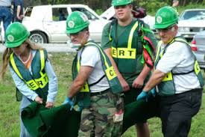
CERT Skills - Group event
This event consists of a two person team event where students’ knowledge of skills in an emergency situations; this event will consist of two rounds of competition for a 2-person team. Round One is a written, 50 multiple choice question test. The top scoring teams will advance to Round Two for the performance of selected skills identified in a written scenario.
This event is good for competitors who are interested in emergencies and how to handle them, questions consists of knowledge about what to do in a fire, in rescue situations, etc. The performance indicators consists of identifying equipment used in medical emergencies. Competitors need to be able to work well and fast together - this doesn’t necessarily mean friends.
Study material:
CERT Online Curriculum http://www.citizencorps.gov/cert/training_mat.shtm
CERT Training Manual (spiral bound book option of the online curriculum)

Slide 30
CPR first aid - Group
This event consists of two rounds of competition for a 2-person team. Round One is a written, multiple-choice test over CPR skills, 50 questions in 60 minutes. The top scoring teams will advance to Round Two for the performance of selected skills identified in a written scenario. The skills will consist of being able to provide first aid and life support on models.
This test is good for those who are skilled in giving CPR and following procedures with team mates, it is very skill intensive so procedures must be followed to the point.
Study Material:
American Heart Association, Basic Life Support for Healthcare Providers, Latest edition.
Distributed by Channing L. Bete Co., Inc. American Heart Association, Heartsaver First Aid CPR AED. Latest edition.
Simmers, L., Simmers-Nartker, Simmers-Kobelak. DHO: Health Science. Cengage Learning, Latest edition.

Slide 31
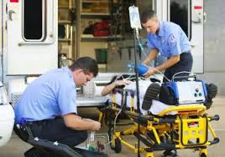
Emergency Medical Technician (EMT)
This event consists of two rounds of competition for a 2-person team. Round One is a written, multiple choice test that has 50 questions to be done in 60 minutes, these questions consist of treatment for patients in emergency situations, such as trauma and basic life support. The top scoring teams will advance to Round Two for the performance of selected skills identified in a written scenario. The skills needed to be performed include sizing up patients and then assessing the body for damage and giving required treatment.
This event is good for those who like to work hands on with medical equipment and especially for those who have take EMT skill related courses at school.
Study material:
Emergency Care and Transportation of the Sick and Injured. Series Editor: Andrew N. Pollak, MD, FAAOS. Published by Jones & Bartlett Learning. Latest edition.
American Heart Association, Basic Life Support for Healthcare Providers, Latest edition. Distributed by Channing L. Bete Co., Inc. – 1-800-611-6083.
Limmer, Daniel. Emergency Care. Published by Prentice Hall, a “Brady” book, Latest edition.
NREMT Basic Level Skill Sheets http://www.nremt.org/nremt/about/psychomotor_exam_emt.asp

Slide 32
Life Support Skills - Special Eligibility Event
Eligibility Rules:
MUST be classified under the provision of the 2004 reauthorized Individuals with Disabilities Education Act (IDEA).
Submit a completed form from the appropriate school official stating that the competitor is classified under the provisions of IDEA 2004 following the submission directions on page 10 of these guidelines. Five (5) bonus points will be awarded to the competitor for submitting the eligibility form correctly.
Event guidelines:
The competitive event will consist of an evaluation of student performance of selected skill(s) identified in a written scenario. The scenario will require the use of critical thinking skills. The performance will be timed and evaluated according to the event guidelines. This consists only of skill based performances.
Study material:
American Heart Association, BLS for Healthcare Providers. Channing L. Bete Co., Inc., 2015.
American Heart Association, Heartsaver First Aid/CPR/AED, Channing L. Bete Co., 2015.

Slide 33
MRC Partnership group event
This event is a large group event that consists of 2 to 6 members, the event is designed to encourage HOSA members to initiate and maintain partnership with their local Medical reserve chapter. Students will work with their Medical reserve and develop a portfolio and then carry out an activity over time that will help a group of people with specific vulnerabilities and to help serve and strengthen the community.
Examples of projects:
Activity: Distributed 72-hour emergency kit supply lists at a local store during peak back-to-school supply shopping.
Impact: Improved community preparedness or resilience
Activity: Mock-disaster victims for school bus crash scenario
Impact: Trained or exercised to improve community response capability
This event requires a lot of time and effort by all group members so good coordination is of utmost importance. This also requires a lot of planning and the ability to work well in a group and to interact with the community a lot.
Notes:
The Civilian Volunteer Medical Reserve Corps (MRC) is a national network of over 200,000 volunteers, organized in almost 1,000 local community-based groups and committed to strengthening public health, reducing vulnerabilities, improving local preparedness, response and recovery capabilities, and building community resilience.

Slide 34
Public Health Presentation
This event consists of a group event of a team of 2-6 members who select a topic to display and present to a panel of judges. This topic will cover a current medical issue and the presentation must be effective, dynamic and creative this presentation should focus on educating the public on the dangers and prevention of diseases or other such medical issues.
Some helpful sources:
http://www.hosa.org/sites/default/files/PH16FINAL.pdf
https://www.usphs.gov/
https://www.apha.org/
This event is good for those who are public speakers and those who can present well, especially in a group, good research skills are also necessary.

Slide 35
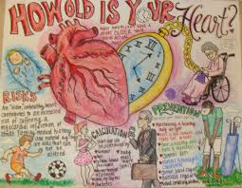
Extemporaneous Health Poster
This event consists of competitors creating a poster to the best of their artistic expression over a certain medical topic; it tests students’ ability to analyze and interpret current health and HOSA-related issues and express and communicate this interpretation through the development of a poster.
This event shall be in the form of an individual creation of a poster conducted in a setting with work tables and sufficient space for each competitor to carry out his/her form of artistic expression, to be completed within three (3) hours of work time.
No pre-constructed props or artwork are to be brought to the site of event
National HOSA shall provide poster board [size: 22" x 28"] (1 per competitor)
Art Supplies are limited to: Pencils, Crayons, Ruler, Instruments used for drawing arcs, angles and curves (I.e: T-square, protractor), Ink pens, Colored markers and colored pencils, Erasers, Charcoal and pastels, Pencil sharpener, Art spray fixative or non-scented hairspray, Wet Wipes, Paper Towels, and White Out.
Personal music player (optional)
Watch with second hand (optional)
Event guidelines (orientation)
This event is great for people who are artistic and can write and draw under pressure. This event is good for imaginative and creative people.

Slide 36
Extemporaneous Writing
Competitors in this event will be able to express themselves in timed writing competition. Competitors will be given one hour to type up an essay on a computer over a topic that will be disclosed at the competition.
Format of paper:
Arial 12 pt. font 1” margins 1.5 spacing, Title of the essay on the top of the first page Last name and competitor number on the top right hand corner of all pages, Page number on the bottom right hand corner of all pages, The pages will be held together by a stapler (if needed), Word Processed in Microsoft Word
This event is great for people who are strong writers and can think quickly and persuasively on healthcare topics.
Competitors will not be given any usage of the internet or online sources, plagiarism is strictly prohibited. Spell check is allowed

Slide 37
Job Seeking Skills
Competitors shall apply for any health related position for which they are trained or are being trained.
Competitors will prepare a cover letter and resume, along with two additional copies
Competitors will complete an application at competition
Students that are neat and have good interpersonal skills will do well in this event. If you have ever had a job interview, this might be a good event to start with!

Slide 38
Health Career Photography
Competitors will use digital photography to illustrate various health professions.
Competitors will photograph three different health professionals performing an aspect of their job, edit the photos using computer software technology as needed, provide a written description of the career and then may present their three printed pictures to a panel of judges.
Photos should portray something about the profession or the skills of the professional.
By looking at the photo, an observer should be able to clearly tell which health profession is being portrayed.
Photos of only medical “procedures” or “Human body parts” with no supporting career reference, and photos including the competitor DO NOT meet the guideline requirements.
Students that like to take pictures will do well in this event. Must be able to get into 3 different types of offices/professions to take pictures, in areas such as local hospitals.

Slide 39
Prepared Speaking event
Competitors shall develop a speech related to a selected national topic
2016 - 2017 Topic: Leadership – Service – Engagement
The prepared speech shall be a maximum of five (5) minutes in length
Use of notes during the speech is permitted. Electronic notecards (on a tablet, smart phone, laptop, etc.) are permitted, but may not be shown to judges.
This event is great for students not afraid to speak in front of new people. You must be able to speak and write well, have varying tones, be in touch with your emotions and not be afraid to show them.

Slide 40
Researched Persuasive Writing & Speaking
Competitors shall write a paper and develop a speech in which they must take a stand, either in favor of or opposed to a health related issue.
Competitors select one of the topics and develop a speech and written paper to reflect the position taken on the selected topic, either for or against, supporting one position or the other.
The topics for 2016-2017 are: Prescription Painkiller Abuse: Who’s At Fault? SmartPhone Addiction-A Problem or a Sign of the Times?
The body of the written research paper should be a maximum of two pages.
The entire paper should be in Arial 12 pt. font on 8 ½ x 11 in. white paper with 1 inch side margins and 1 inch top and bottom margins. The written research paper must be typed or word-processed and double-spaced.
The speech may or may not be worded exactly as written in the researched written paper
The speech may be up to four (4) minutes in length.

Slide 41
Biomedical Debate (Group Event)
This event consists of two rounds, a written first round and then a second round in which competitors debate. The topics for the debate will be announced annually so be on the lookout for the topics that will be on the official HOSA website. Competitors will have the opportunity to research the biomedical topic and then debate against other groups in front of a judge. Round one will be a 50 multiple choice test that will take 60 minutes.
Teams would have two (2) minutes to prepare outside the competition room. At least three (3) team members must speak in the debate.
Teams will be permitted to bring prepared materials (Containers/folders with notes, printed pages, books and bound materials) to the presentation area in hard copy only.
Students who are good at arguing or are in debate should take this event, this is event requires lots of coordination and practice so all members must have lots of free time.
Study material:
For the official format of the debate http://www.hosa.org/sites/default/files/BD%2016%20final_0.pdf
https://www.boundless.com/economics/textbooks/boundless-economicstextbook/health-care-economics-35/introducing-health-care-economics- 135/different-health-care-systems-around-the-world-533-12630/

Slide 42
Community Awareness Event
This event consists of students working to develop a project to benefit the community
Addresses one specific health or safety issue
Should have a direct relationship to the organization’s purposes
Activities are planned to make the community aware and documented
Team of 2-4 competitors

Slide 43
Creative Problem Solving
Two rounds of competition
Round one: written test evaluating competitors’ understanding
Creative Problem Solving 101, Creative Thinkering
Top scoring teams then move onto round two
Given a problem related to HOSA or the community
Given 30 minutes to analyze problem with team
Eight minutes to present solution to judges

Slide 44
Forensic Medicine
Two rounds of competition
Round One: written test
Round Two:
Given a case study
Will have six minutes to analyze a case study
Given 30 minutes to write their conclusions

Slide 45
Health Career Display/Health Education
Two competitors create a visual display relating to a specific career or career cluster in health
Consists of two rounds of competition
Health Education:
Team of 2-4 members
Prepare a lesson on a health-related concept and evaluate results
Must include use of presentation tools such as student-made video

Slide 46
Hosa Bowl/Medical Innovation
3-4 members
Two rounds
Round One: written test
Round Two: answer questions
Winners will be determined by a series of elimination rounds
Section winners play in final rounds to determine top three teams
Medical Innovation
2-4 competitors
Demonstration of a medical innovation

Slide 47
Parliamentary Procedure/PSA
Two rounds of competition
Round one is a test
Round two:
Given a secret problem with motions to perform during the meeting
PSA:
3-6 members
30 second PSA video
Round One: viewing of the PSA by judges
Round Two: presentation

